Slide 1
Transitioning to Scrum-Agile:
Transitioning to Scrum-Agile:
Lessons from the SNHU travel project.
By: Lorenzo Ginyard

Slide 2
Agile Roles
PROUCT OWNER
SCRUM MASTER
DEVELOPER
Executes tasks, collaborates on deliverables.
Ensures adherence to Scrum, facilitates processes.
Manages the backlog, prioritizes user stories
TESTER
Test product to provide feedback and issues.

Slide 3

Explaining Agile Phases
Sprint Planning
Define sprint goals and backlog items
Daily Stand-ups
Discuss progress and blockers
Sprint Review
Demonstrate completed work to stakeholders
Sprint Retrospective
Reflect on the sprint and identify improvements

Slide 4
THE WATERFALL MODEL
The waterfall model is a traditional software development methodology characterized by a linear and sequential approach. It consists of distinct phases, where each phase must be completed before the next one begins.
Development progresses through clearly defined stage requirements: Design, Implementation, testing, deployment, and maintenance without overlapping.
Each phase produces comprehensive documentation, ensuring clarity and traceability throughout the project.
Once a phase is completed, revisiting it can be difficult and costly, making the model less adaptable to changing requirements.
Each phase has specific deliverables and milestones, allowing for easy progress tracking and management.
Ideal for projects with well-understood and stable requirements, such as in industries like construction or manufacturing.
Changes in requirements can be costly and time-consuming in a waterfall model.

Slide 5
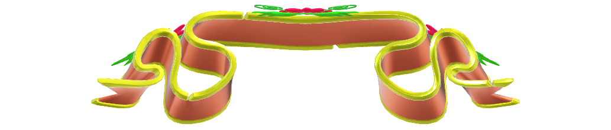

WATERFALL MODEL VS SCRUM-AGILE
WATERFALL
AGILE
VS
Structure: Linear and Sequential: Development progresses through distinct phases: requirements, design, implementation, testing, deployment, and maintenance. Fixed Scope: Changes are difficult and costly once a phase is completed. Documentation: Extensive Documentation: Each phase requires thorough documentation, providing clear guidelines and requirements. Flexibility: Inflexible to Changes: Changes to requirements mid-project are challenging to accommodate, making it less suitable for projects with evolving needs. Testing: Late Testing: Testing occurs after implementation, which can lead to discovering critical issues late in the process. Best Suited For: Stable Projects: Works well for projects with well-defined requirements, such as construction or manufacturing. | Structure: Iterative and Incremental: Development occurs in iterative cycles (sprints), allowing for continuous feedback and improvement. Adaptive Scope: Requirements can evolve based on user feedback and changing priorities. Documentation: Minimal Documentation: Focuses on essential documentation, with an emphasis on collaboration and communication. Flexibility: Highly Flexible: Agile accommodates changes at any stage, allowing teams to respond quickly to new information or client needs. Testing: Continuous Testing: Testing is integrated throughout the development process, allowing for early detection of issues. Best Suited For: Dynamic Projects: Ideal for projects with uncertain or evolving requirements, such as software development in fast-paced environments.

Slide 6
REFERENCES
Royce, W. W. (1970). Managing the Development of Large Software Systems. Proceedings of IEEE WESCON, 1-9. Available here
Sommerville, I. (2011). Software Engineering (9th ed.). Addison-Wesley. ISBN: 978-0137035151
Boehm, B. W. (1988). A Spiral Model of Software Development and Enhancement. ACM SIGSOFT Software Engineering Notes, 11(4), 14-24. DOI: 10.1145/74334.74337
Pressman, R. S., & Maxim, B. R. (2014). Software Engineering: A Practitioner's Approach (9th ed.). McGraw-Hill. ISBN: 978-0073375977
Kneafsey, S. The Five Scrum Events - TheScrumMaster.co.uk Available online: https://www.thescrummaster.co.uk/scrum/the-five-scrum-events/ (accessed on 10 October 2024).
Smith, J. (2018). Agile Project Management: A Comprehensive Guide. New York, NY: Wiley
Jones, S., & Johnson, M. (2017). Scrum: The Art of Doing Twice the Work in Half the Time. New York, NY: Currency

